Slide 1
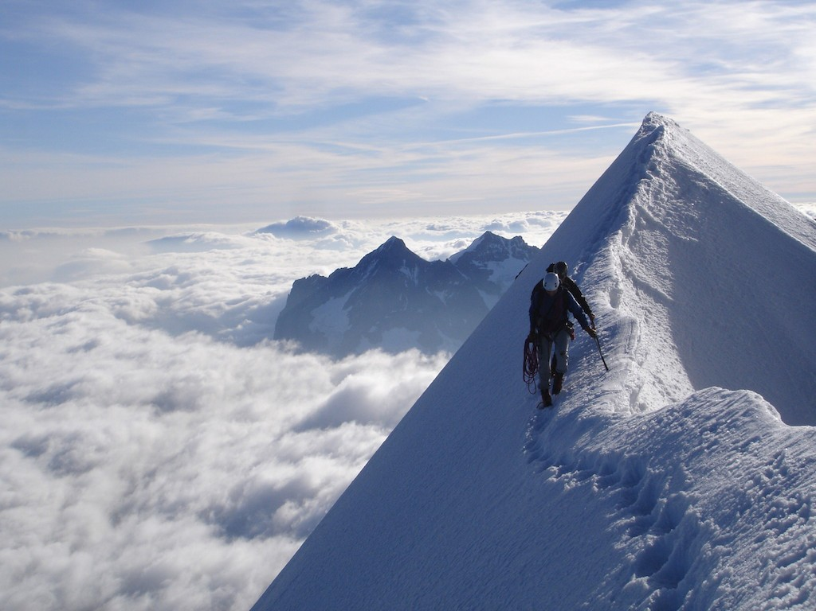
“To be is to be the value of a variable.”
- William Quine
Variables

Slide 2
Announcements
Pset 1 and prog 1 were due yesterday
Pset 2 and prog 2 are going out today
Tiny (intro) email backlog
Probability Review is… TBA still
Mistake on Alpha / Beta agent algorithm

Slide 3
Alpha Beta Pruning
def miniMax(self, node, depth, alpha, beta, isMax):
if node.isTerminal():
if isMax return node.utility()
return –node.utility()
if depth == 0:
return self.getHeuristic(node)
if isMax:
for action in node.getLegalActions():
child = node.getSuccessorState(action)
value = miniMax(child, depth -1, alpha, beta, not isMax)
alpha = max(alpha, value)
if beta <= alpha: break
return alpha
else:
for action in node.getLegalActions():
child = node.getSuccessorState(action)
value = self.miniMax(child, depth -1, alpha, beta, not isMax)
beta = min(value, beta)
if beta <= alpha: break
return beta
return node.utility()

Slide 4
Programming Assignment Time

Slide 5
Programming Assignment Time
Consider asking for help.
Email your TA (or rock on)

Slide 6
Problem Set Question Time

Slide 7
Problem Set Question Time
Total:
28 Hours / Student
Ideal:
26 Hours / Student
Units:
4.2 unit class ☺

Slide 8

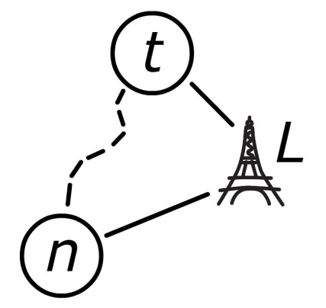

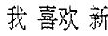
Homework Preference

Slide 9
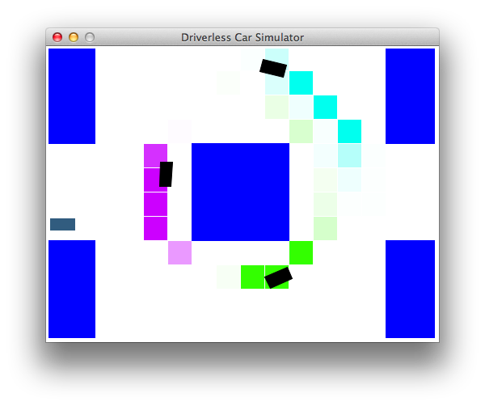
Driverless Car
Important Algo.
Easy to Visualize
Less Time
Driverless Car

Slide 10
CS221
Search
Machine Learning
Variable Based

Slide 11

CS221
Search
Machine Learning
Variable Based

Slide 12
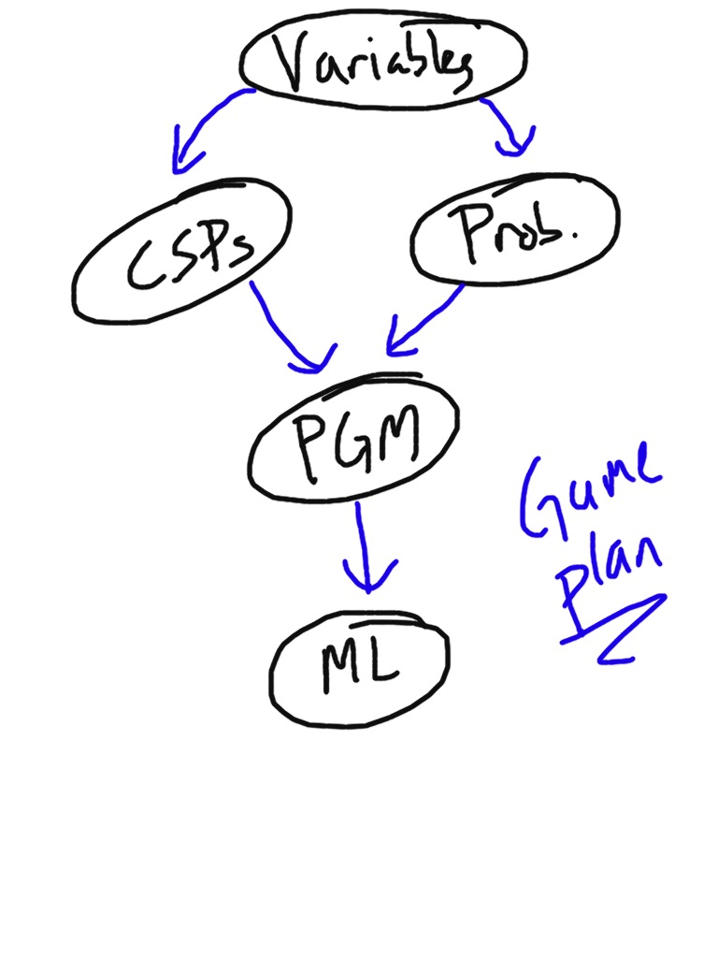

Slide 13


Slide 18

Image Segmentation

Slide 19
Image Segmentation
Claire
Chris
Home

Slide 20

Image Segmentation

Slide 21

Image Segmentation

Slide 22
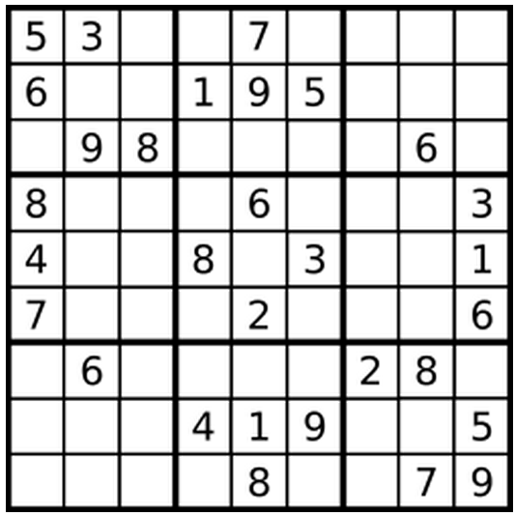
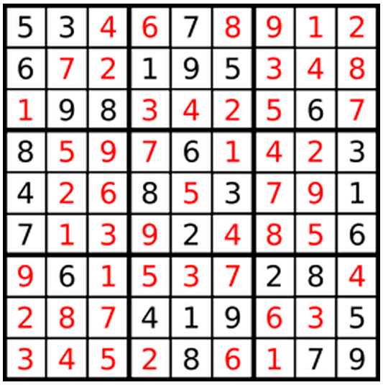
Motivating Example

Slide 23
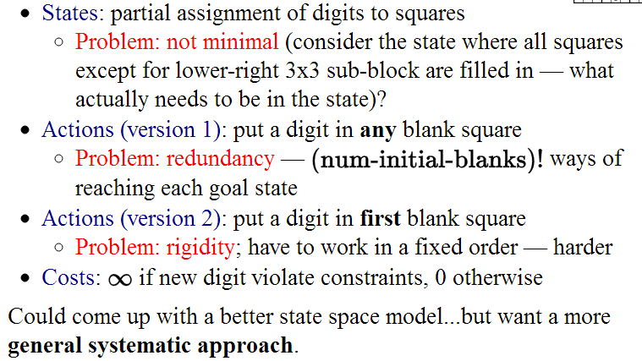
Motivating Example

Slide 24
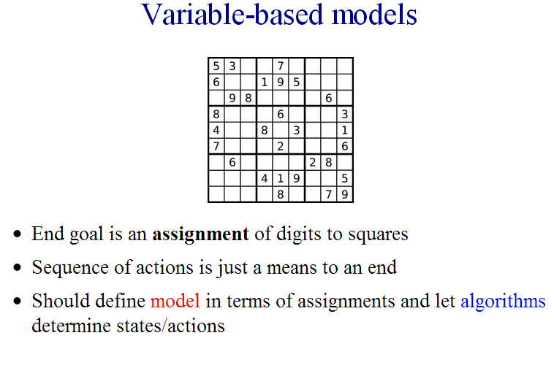
CSPs
Commutatively: the order of application of actions has no effect on outcome

Slide 25
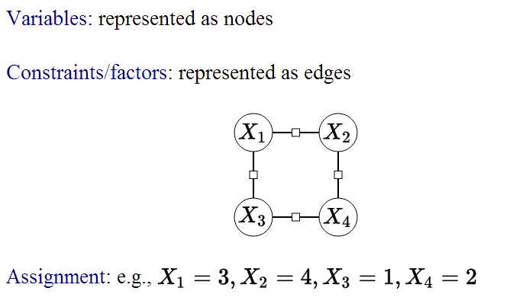
CSPs

Slide 26
CSPs
Interesting in their own right
Introduction to variable based models
Inference is very similar to … [super secret stuff]

Slide 27
CSPs
Formalization
Inference
Search
Improved Search
Arc Consistency
Graph Structure
Genetic Algorithms
Weighted CSPs
Image Segmentation

Slide 28
The AI Pipeline
Real World Problem
Model the problem
Formal Problem
Apply an Algorithm
Evaluate
Solution

Slide 29
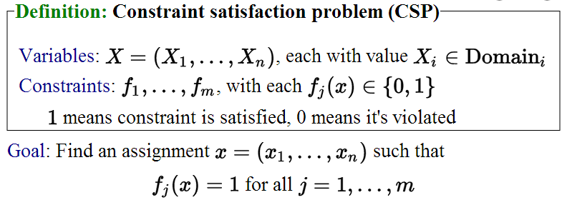
Formally

Slide 30
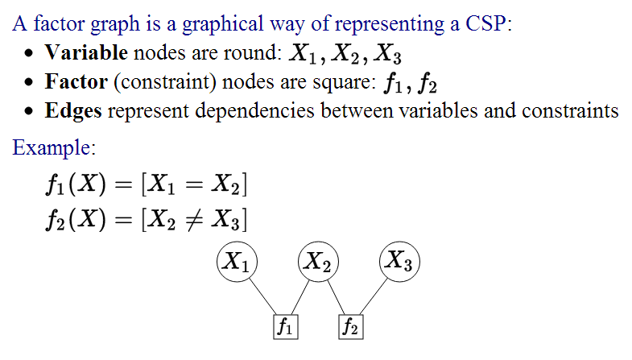
Factor Graphs

Slide 31
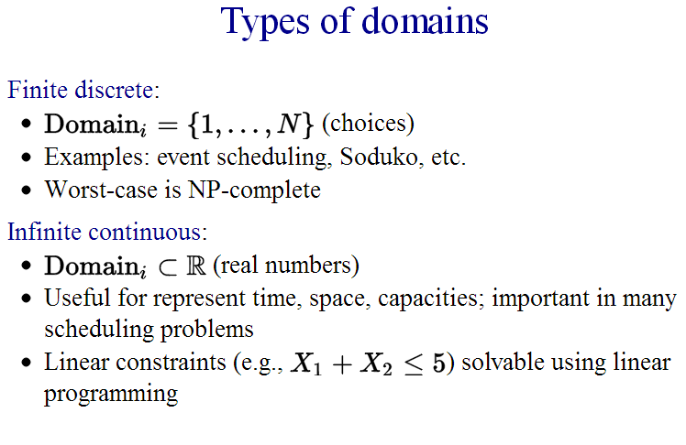
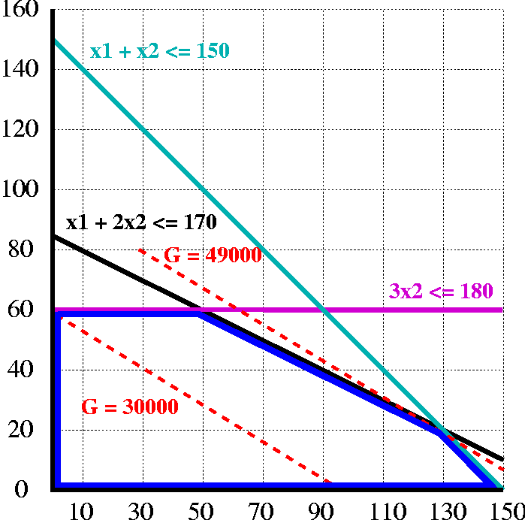

Types of Domains

Slide 32
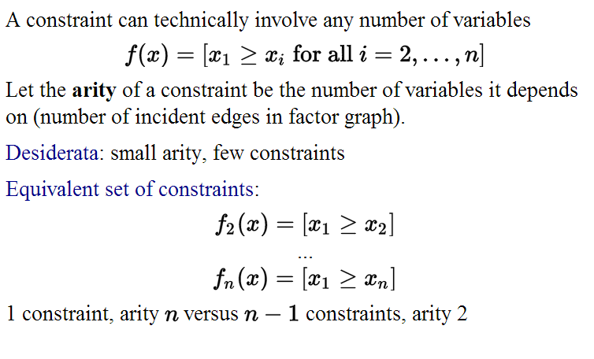
Constraints

Slide 33
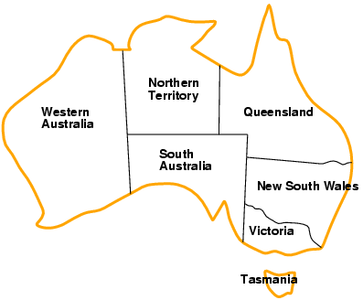
Example: Map Coloring
Variables WA, NT, Q, NSW, V, SA, T
Domains D_{i} = {red,green,blue}
Constraints: adjacent regions must have different colors
e.g., WA ≠ NT, or (WA,NT) in {(red,green),(red,blue),(green,red), (green,blue),(blue,red),(blue,green)}

Slide 34
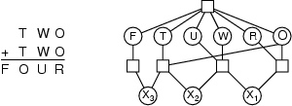
Example: Crypto
Variables: F T U W R O X₁ X₂ X₃
Domains: {0,1,2,3,4,5,6,7,8,9}
Constraints:
Alldiff (F,T,U,W,R,O)
O + O = R + 10 · X₁
X₁ + W + W = U + 10 · X₂
X₂ + T + T = O + 10 · X₃
X₃ = F, T ≠ 0, F ≠ 0

Slide 35
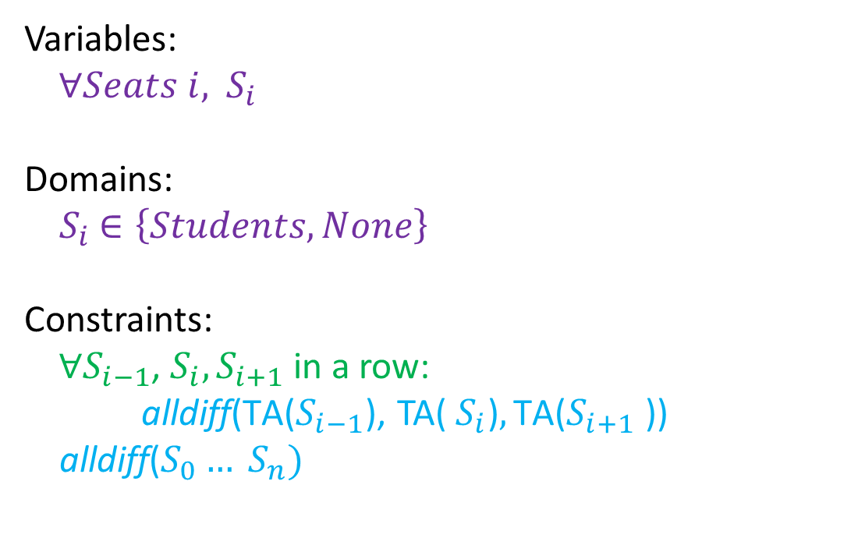
Example: Student Seats
Go!

Slide 36
The AI Pipeline
Real World Problem
Model the problem
Formal Problem
Apply an Algorithm
Evaluate
Solution

Slide 37
Inference
1. Search
2. Constraint Propagation

Slide 38
Example 2: Map Coloring
Variables WA, NT, Q, NSW, V, SA, T
Domains D_{i} = {red,green,blue}
Constraints: adjacent regions must have different colors
e.g., WA ≠ NT, or (WA,NT) in {(red,green),(red,blue),(green,red), (green,blue),(blue,red),(blue,green)}

Slide 39
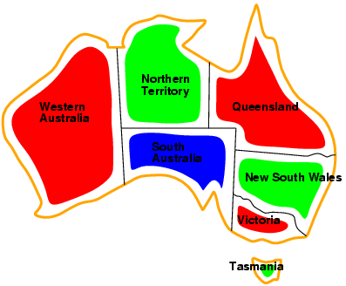
Example 2: Map Coloring
Solutions are complete and consistent assignments, e.g., WA = red, NT = green,Q = red,NSW = green,V = red,SA = blue,T = green

Slide 40
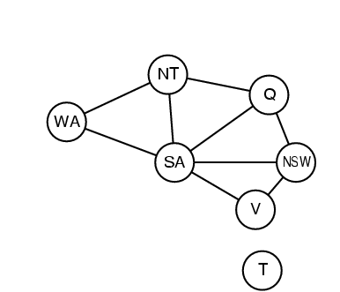
Example 2: Map Coloring
Binary CSP: each constraint relates two variables
Constraint graph: nodes are variables, arcs are constraints

Slide 41
Inference
1. Search
2. Constraint Propagation

Slide 42

Search

Slide 43
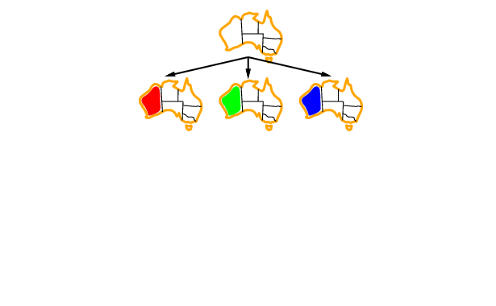
Search

Slide 44
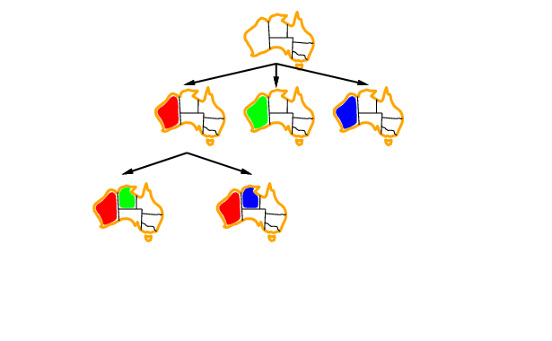
Search

Slide 45
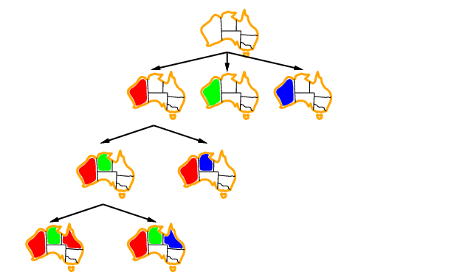
Search

Slide 46
Improved Search
General-purpose methods can give huge gains in speed:
Which variable should be assigned next?
In what order should its values be tried?
Can we detect inevitable failure early?

Slide 47

Most Constrained Variable
Choose the variable with the fewest legal values
a.k.a. minimum remaining values (MRV) heuristic

Slide 48

Most Constraining Variable
Tie-breaker among most constrained variables
Choose the variable with the most constraints on remaining variables

Slide 49
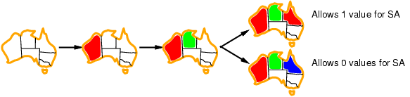
Least Constraining Assignment
Given a variable, choose the assignment that rules out the fewest values in the remaining variables
Fun fact: Combining these heuristics makes 1000 queens feasible

Slide 50
Inference
1. Search
2. Constraint Propagation

Slide 51
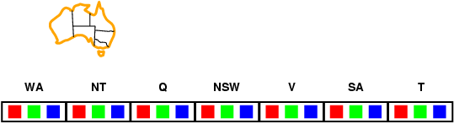
Forward Checking
Idea:
Keep track of remaining legal values for unassigned variables
Terminate search when any variable has no legal values

Slide 52
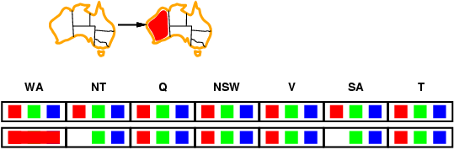
Forward Checking
Idea:
Keep track of remaining legal values for unassigned variables
Terminate search when any variable has no legal values

Slide 53
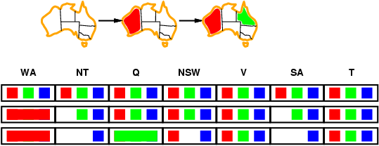
Forward Checking
Idea:
Keep track of remaining legal values for unassigned variables
Terminate search when any variable has no legal values

Slide 54
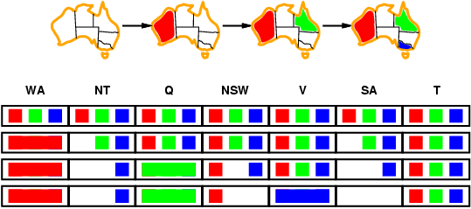
Forward Checking
Idea:
Keep track of remaining legal values for unassigned variables
Terminate search when any variable has no legal values
Other ways to catch other failures

Slide 55
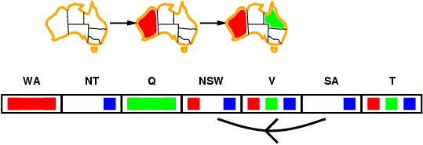
Arc Consistency
At each iteration, make each arc consistent

Slide 56
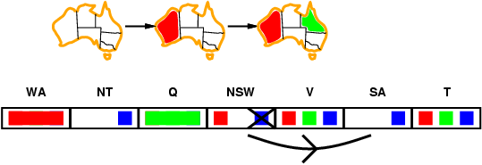
Arc Consistency
At each iteration, make each arc consistent

Slide 57
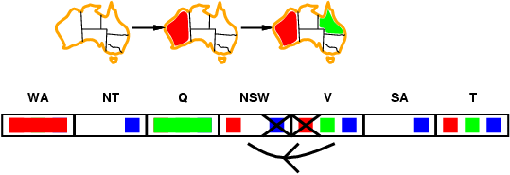
Arc Consistency
At each iteration, make each arc consistent

Slide 58
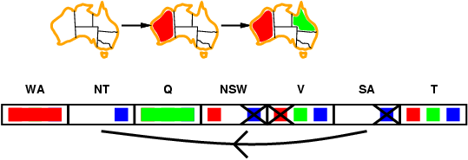
Arc Consistency
At each iteration, make each arc consistent

Slide 59
Graph Structure

Slide 60
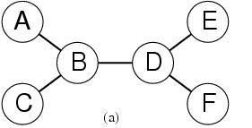
Trees are Easy
Theorem:
If a constraint graph has no loops then the CSP can be solved in O(nd ²) time
linear in the number of variables!
Compare difference with general CSP, where worst case is O(d ^{n})

Slide 61
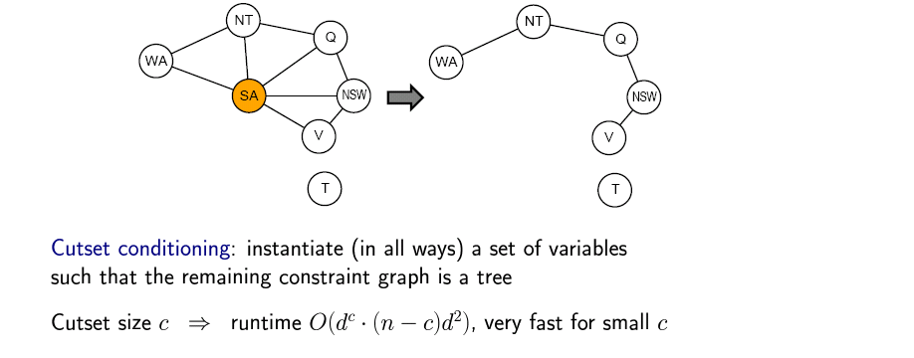
Non Trees

Slide 62
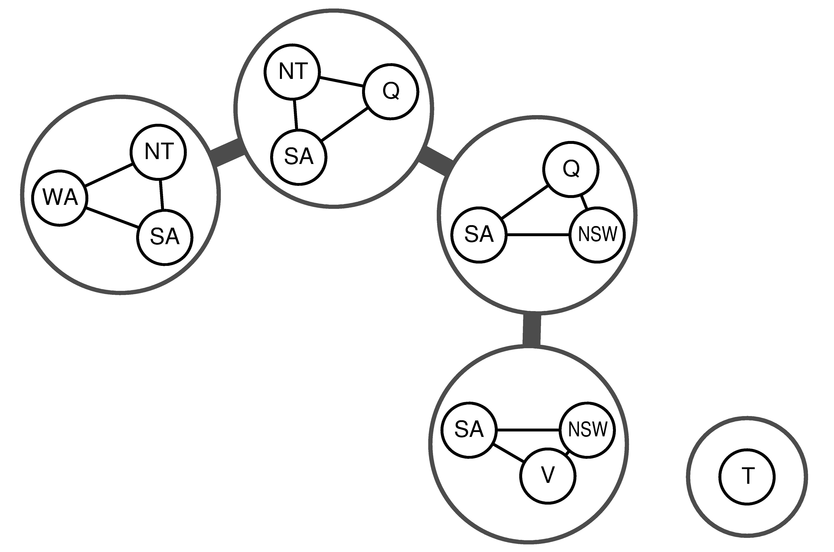
Tree Decomposition

Slide 63
Motivating Example
Sudoku becomes easy (under 0.1s)

Slide 64
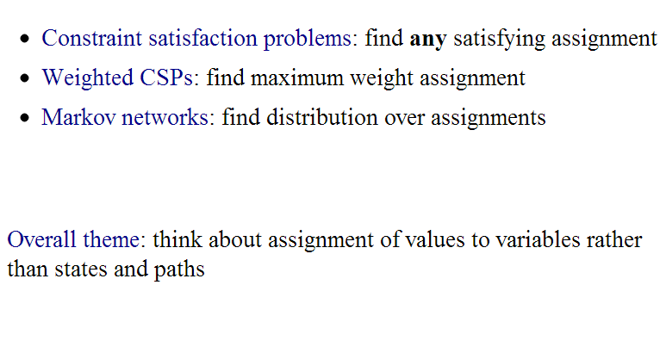
Flavors

Slide 65
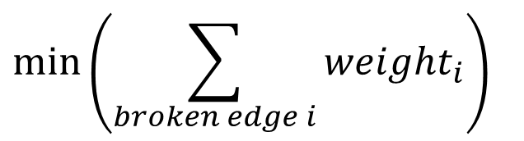
Weighted CSP
A
weight
B

Slide 66
Demo Example

Slide 67
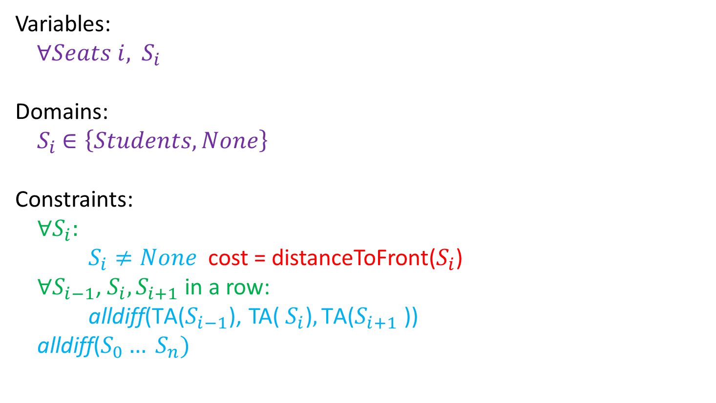
Demo Example

Slide 68

Image Segmentation?

Slide 69

Image Segmentation?

Slide 70
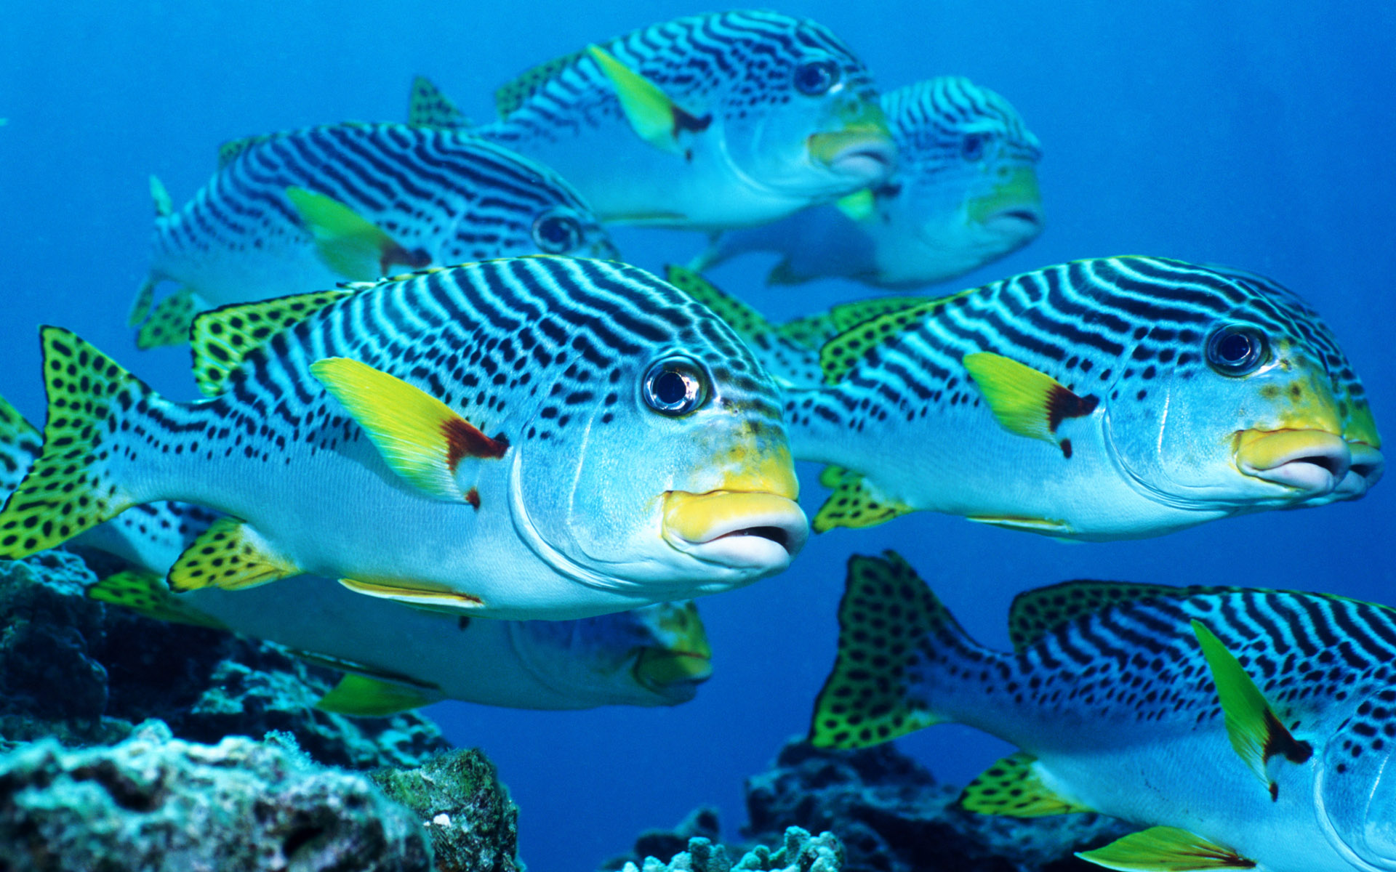
Genetic Algorithms
Variables D = (D₁, D₂ … D_{n}) each with domain = {A, T, G, C}
Try searching by creating populations, mating them with one another and mutating every once in a while.
Just for fun!

Slide 71
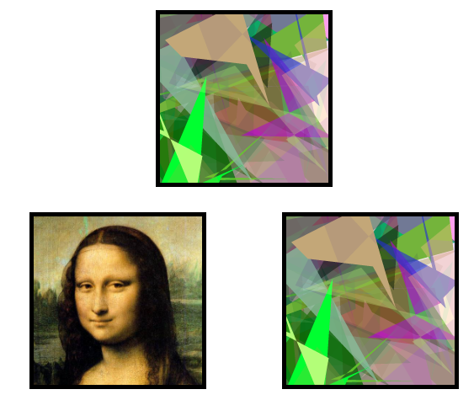

Genetic Algorithms
Just for fun!

Slide 72


Genetic Algorithms
Just for fun!

Slide 73

Theme?

Slide 74


Slide 77
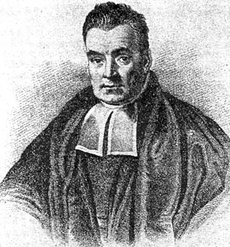

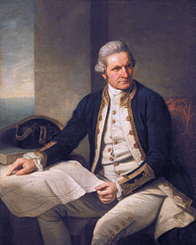
Probability
Mehran
Sahami

Slide 78


Motivating Example

Slide 79
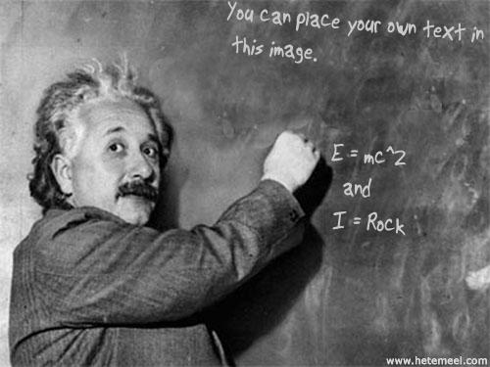

Slide 80

And The Revolution Starts…

